Slide 1
React Fundamentals
Module -3

Slide 2
What is React ?
React is a JavaScript library for building user interfaces (UIs) on the web. React is a declarative, component based library that allows developers to build reusable UI components and It follows the Virtual DOM (Document Object Model) approach, which optimizes rendering performance by minimizing DOM updates. React is fast and works well with other tools and libraries.

Slide 3
History of React
React was invented by Facebook developers who found the traditional DOM slow. By implementing a virtual DOM, React addressed this issue and gained popularity rapidly.
The current stable version of ReactJS is 18.2.0, released on June 14, 2022. The library continues to evolve, introducing new features with each update.

Slide 4
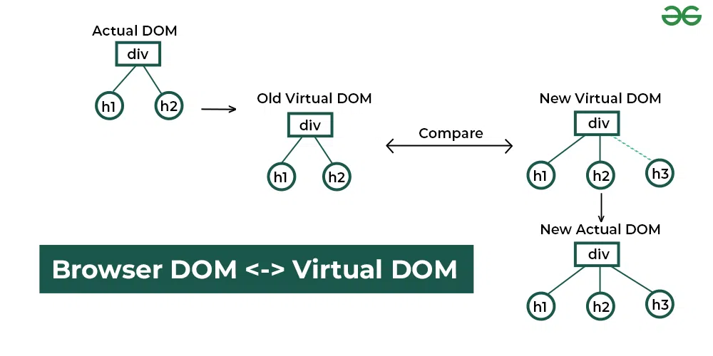
How does React work?
React operates by creating an in-memory virtual DOM rather than directly manipulating the browser’s DOM. It performs necessary manipulations within this virtual representation before applying changes to the actual browser DOM. React is efficient, altering only what requires modification.

Slide 5
Features of React
React is one of the most demanding JavaScript librarys because it is equipped with a ton of features which makes it faster and production-ready.
1. Component-Based Architecture
React provides the feature to break down the UI into smaller, self-contained components. Each component can have its own state and props..
2. JSX (JavaScript Syntax Extension)
JSX is a syntax extension for JavaScript that allows developers to write HTML-like code within their JavaScript files. It makes React components more readable and expressive.
const name="GeekforGeeks";
const xyz = <h1>Welcome to {name}</h1>;

Slide 6
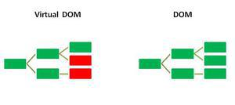
3. Virtual DOM
React maintains a lightweight representation of the actual DOM in memory. When changes occur, React efficiently updates only the necessary parts of the DOM.

Slide 7
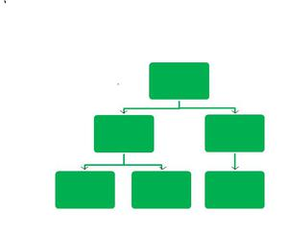
4. One-way Data Binding
One-way data binding, the name itself says that it is a one-direction flow. The data in react flows only in one direction i.e. the data is transferred from top to bottom i.e. from parent components to child components. The properties(props) in the child component cannot return the data to its parent component but it can have communication with the parent components to modify the states according to the provided inputs.

Slide 8
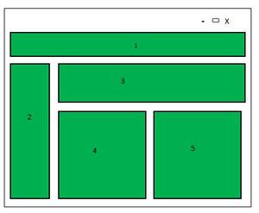
5. Performance
As , react uses virtual DOM and updates only the modified parts. So , this makes the DOM to run faster. DOM executes in memory so we can create separate components which makes the DOM run faster.
6. Components
React divides the web page into multiple components as it is component-based. Each component is a part of the UI design which has its own logic and design as shown in the below image. So the component logic which is written in JavaScript makes it easy and run faster and can be reusable.

Slide 9
7. Single-Page Applications (SPAs)
React is recommended in creating SPAs, allowing smooth content updates without page reloads. Its focus on reusable components makes it ideal for real-time applications.

Slide 10
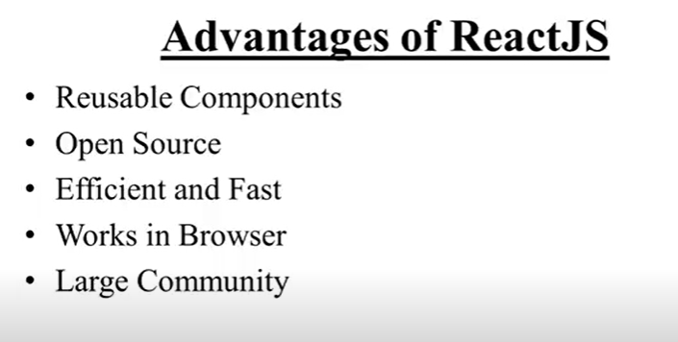

Slide 11
Components
Components are independent and reusable bits of code. They serve the same purpose as JavaScript functions, but work in isolation and return HTML.
Components come in two types, Class components and Function components, in this tutorial we will concentrate on Function components.

Slide 12
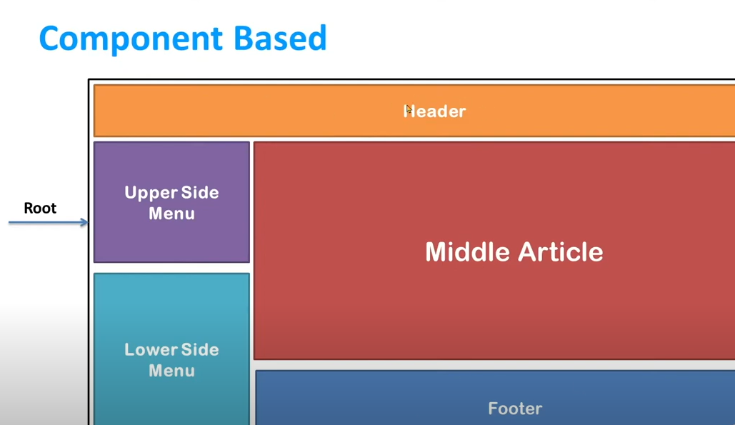

Slide 13
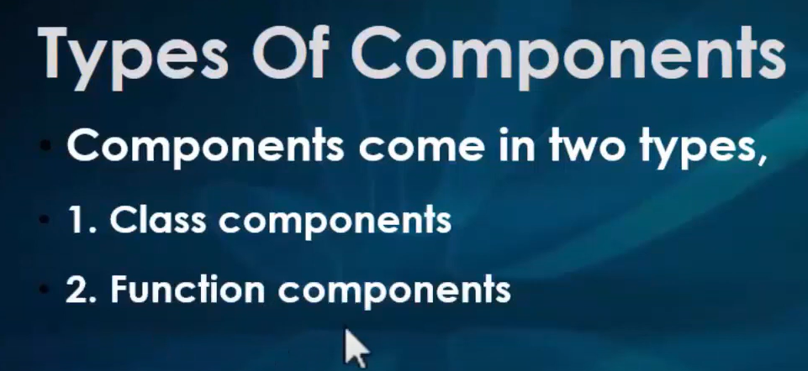

Slide 14
Class Component
A class component must include the extends React.Component statement. This statement creates an inheritance to React.Component, and gives your component access to React.Component's functions.
The component also requires a render() method, this method returns HTML.

Slide 15
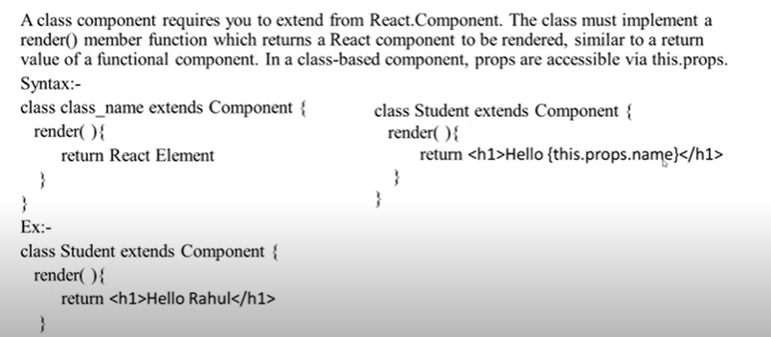
Class Components

Slide 16
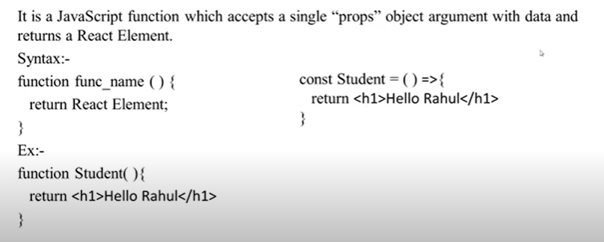
Function Component

Slide 17
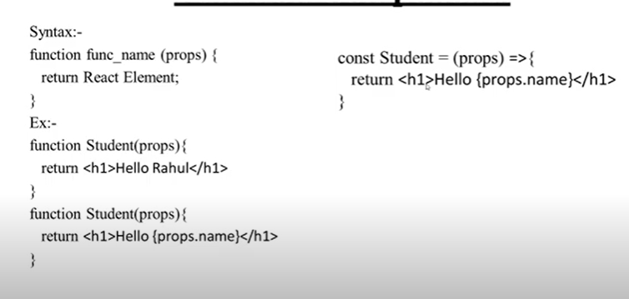

Slide 18
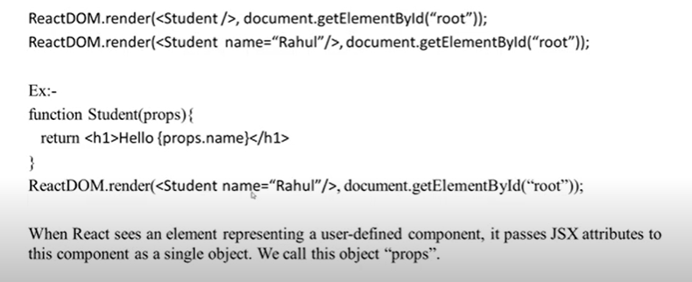
Rendering a Component

Slide 19
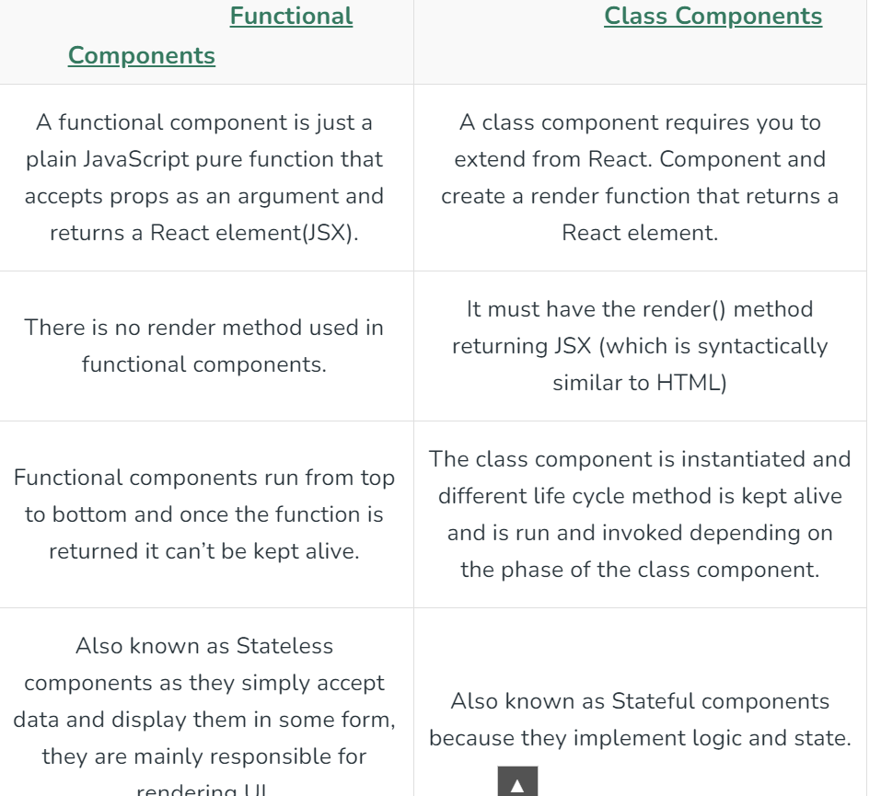

Slide 20
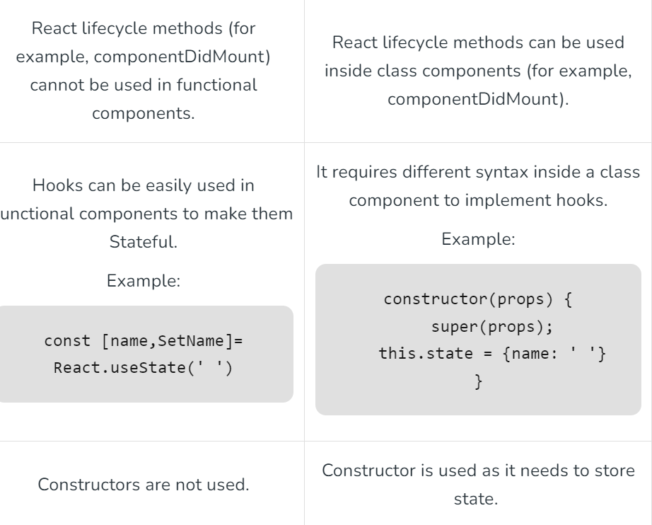

Slide 21
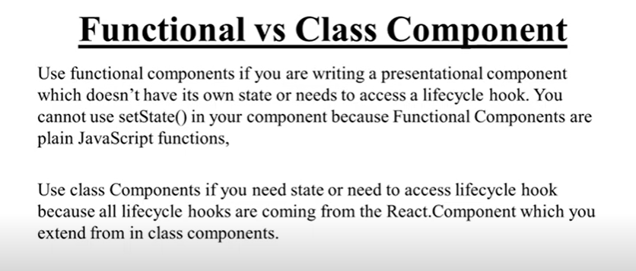

Slide 22


Slide 23
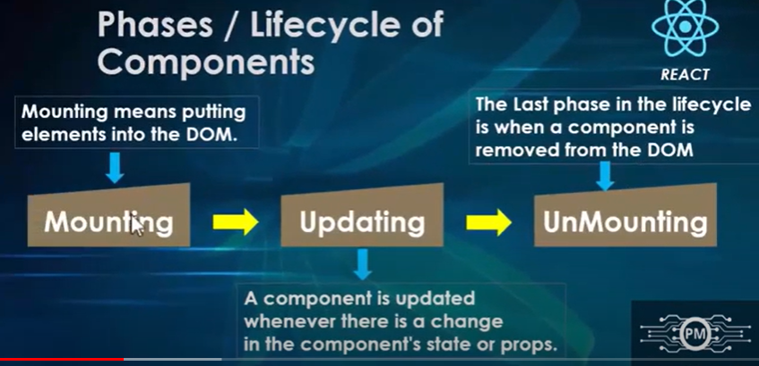

Slide 24


Slide 25
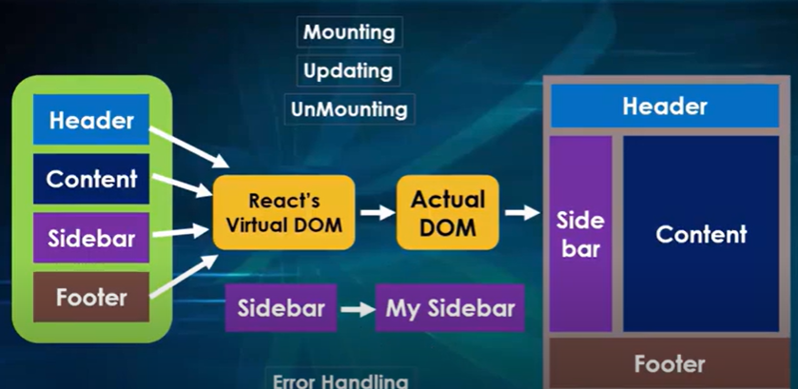

Slide 26


Slide 27


Slide 28


Slide 29
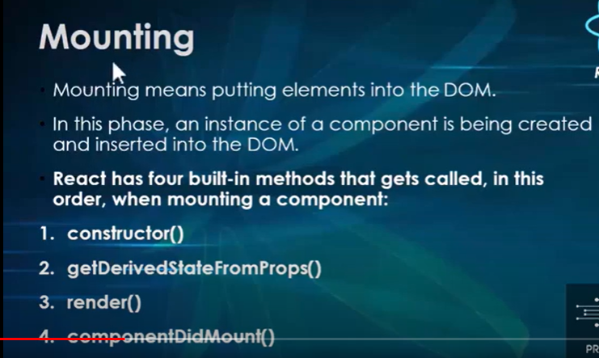

Slide 30


Slide 31


Slide 32

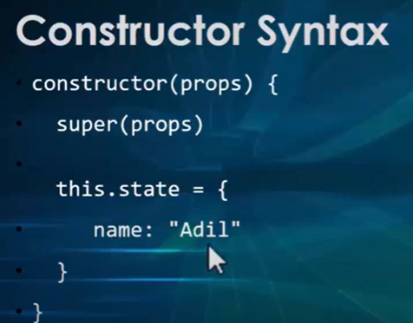

Slide 33


Slide 34



Slide 35
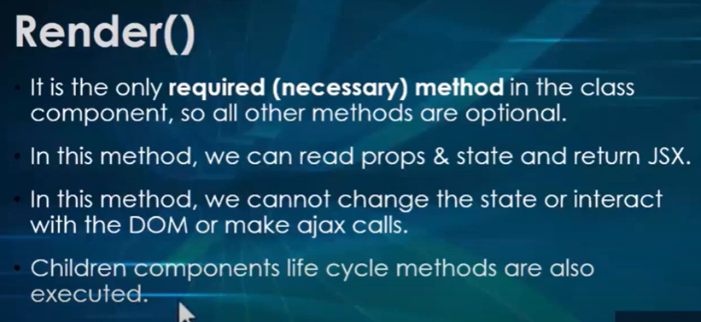

Slide 36


Slide 37


Slide 38


Slide 39
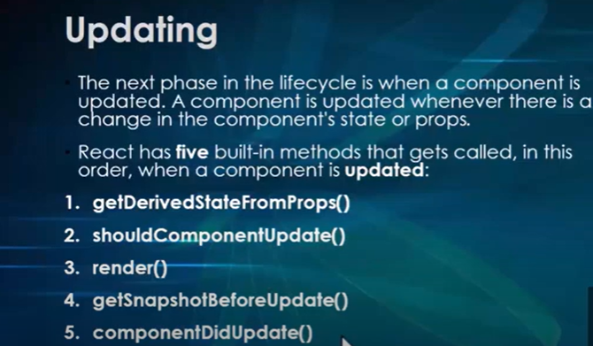

Slide 40


Slide 41


Slide 42



Slide 43
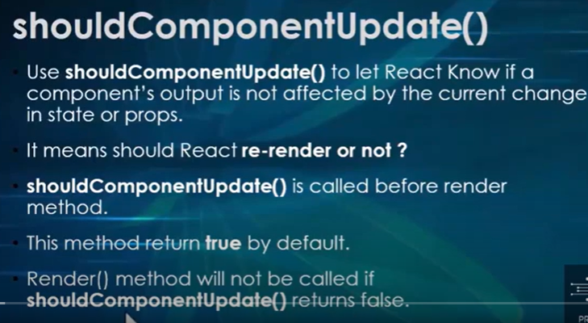

Slide 44



Slide 45


Slide 46



Slide 47


Slide 48


Slide 49


Slide 50


Slide 51


Slide 52
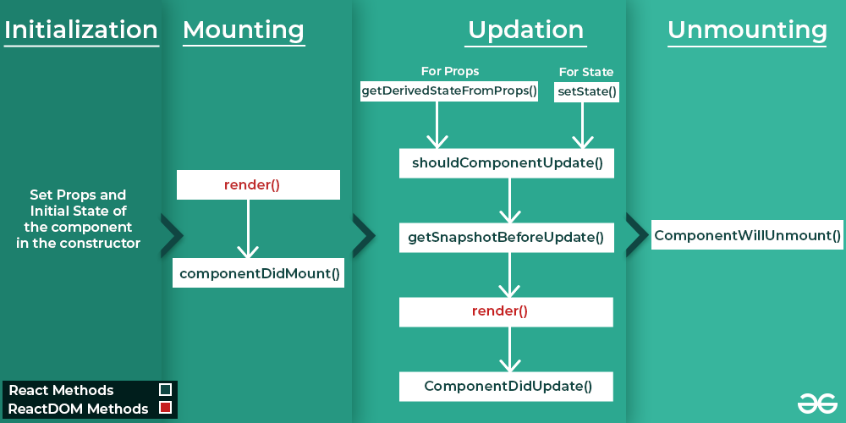

Slide 53
Props
Props stand for "Properties." They are read-only components.
It is an object which stores the value of attributes of a tag and work similar to the HTML attributes.
It gives a way to pass data from one component to other components.
It is similar to function arguments. Props are passed to the component in the same way as arguments passed in a function.
Props are immutable so we cannot modify the props from inside the component. Inside the components, we can add attributes called props.
When we need immutable data in the component, we have to add props to reactDom.render() method in the main.js file of your ReactJS project and used it inside the component in which you need.

Slide 54
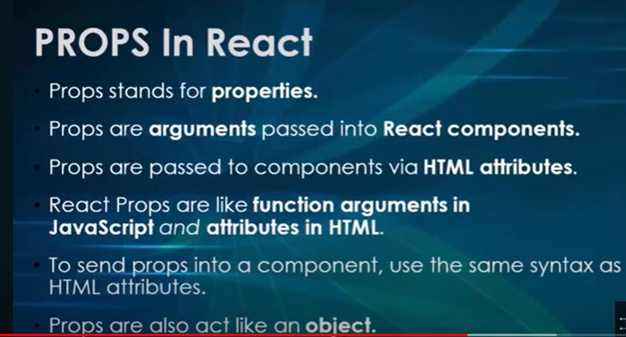

Slide 55


Slide 56
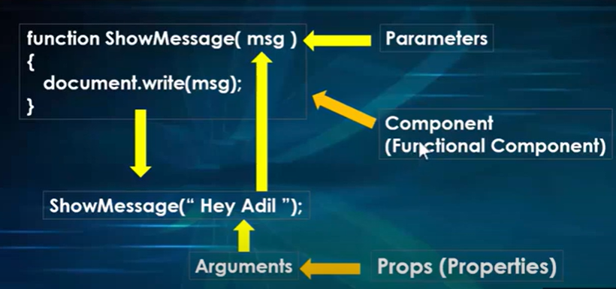

Slide 57
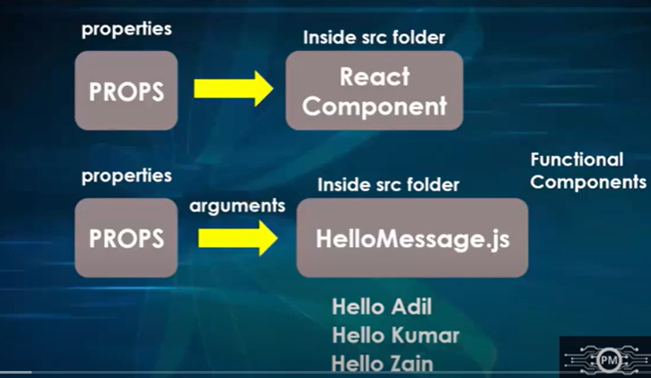

Slide 58
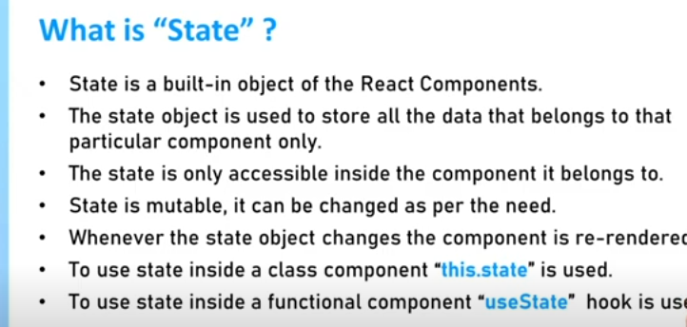

Slide 59


Slide 60
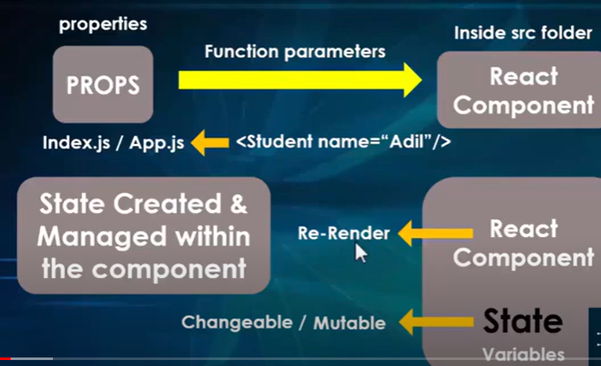

Slide 61


Slide 62


Slide 63


Slide 64


Slide 65


Slide 66
Difference between State and Props
SN | Props | State
1. | Props are read-only. | State changes can be asynchronous.
2. | Props are immutable. | State is mutable.
3. | Props allow you to pass data from one component to other components as an argument. | State holds information about the components.
4. | Props can be accessed by the child component. | State cannot be accessed by child components.
5. | Props are used to communicate between components. | States can be used for rendering dynamic changes with the component.
6. | Stateless component can have Props. | Stateless components cannot have State.
7. | Props make components reusable. | State cannot make components reusable.
8. | Props are external and controlled by whatever renders the component. | The State is internal and controlled by the React Component itself.

Slide 67


Slide 68


Slide 69


Slide 70
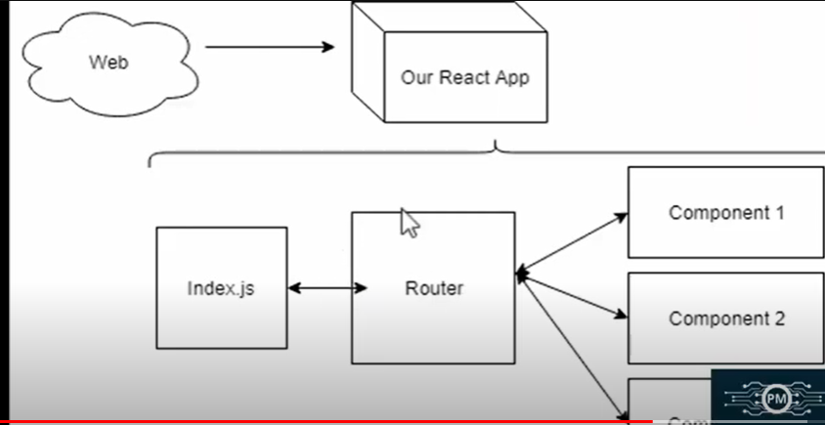

Slide 71


Slide 72


Slide 73


Slide 74


Slide 75
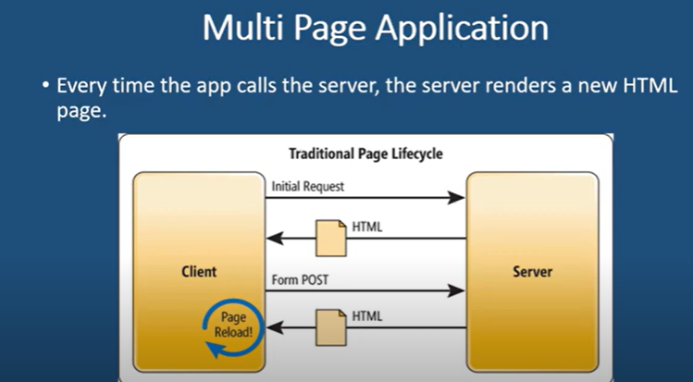

Slide 76


Slide 77
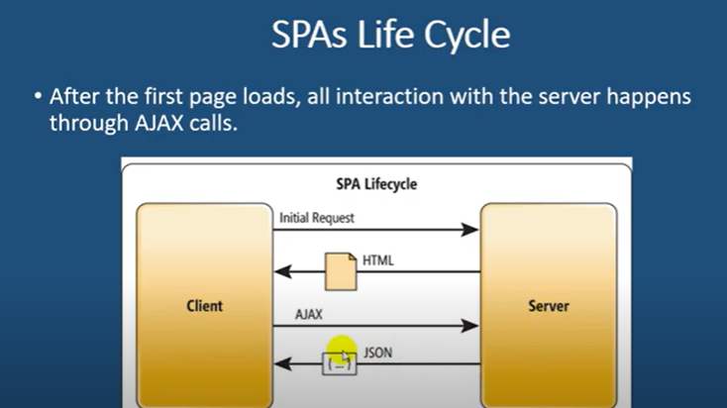

Slide 78
Advantage of SPA
1. Quick Loading Time
With the SPA approach, your full page loads quicker than traditional web applications, as it only has to load a page at the first request. On the other hand, traditional web apps have to load pages at every request, taking more time.
2. Seamless User Experience
SPAs deliver an experience like a desktop or mobile app. Users do not have to watch a new page load, as only the content changes, not the page, making the experience enjoyable.

Slide 79
3. Ease in Building Feature-rich Apps
SPA application makes adding advanced features to a web application easy. For example, it is easier to build a content-editing web app with real-time analysis using SPA development. Doing this with a traditional web app requires a total page reload to perform content analysis.
4. Uses Less Bandwidth
It is no surprise that SPAs consume less bandwidth since they only load web pages once. Besides that, they can also do well in areas with a slow internet connection. Hence, it is convenient for everyone, regardless of internet speed.

Slide 80
Disadvantage of SPA
1. Doesn’t Perform Well With SEO
2. Uses a Lot of Browser Resources
3. Security Issues

Slide 81


Slide 82
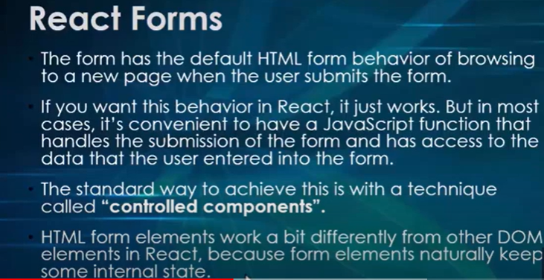

Slide 83


Slide 84


Slide 85


Slide 86
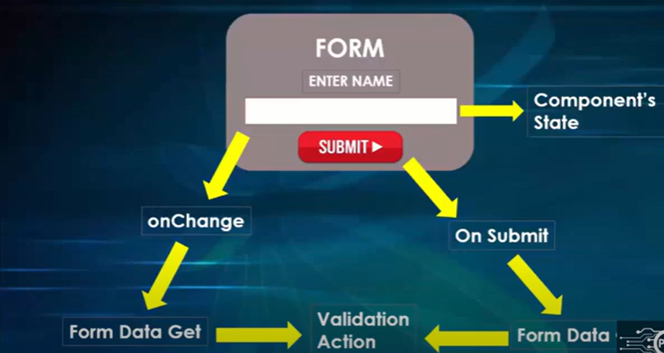

Slide 87


Slide 88


Slide 89


